Slide 1

SWE 321: Data Communication
SWE 321: Lecture 07
Afsana Begum
Department of Software Engineering
Daffodil International University

Slide 2
Overview:
Review
Analog Transmission
Digital-to-Analog Conversion
Amplitude Shift Keying (ASK)
Frequency Shift Keying (FSK)
Phase Shift Keying (PSK)
Data Link Control
Flow Control
Error Control

Slide 3
Analog Transmission:
Previously we saw that digital transmission is very desirable, for that a low-pass channel is needed.
However, We also saw that analog transmission is the only choice if we have a band pass channel.
Here we will discuss about different type of analog transmission.
Analog Transmission are two type:
Digital-to-Analog Transmission
Analog-to-Analog Transmission

Slide 4
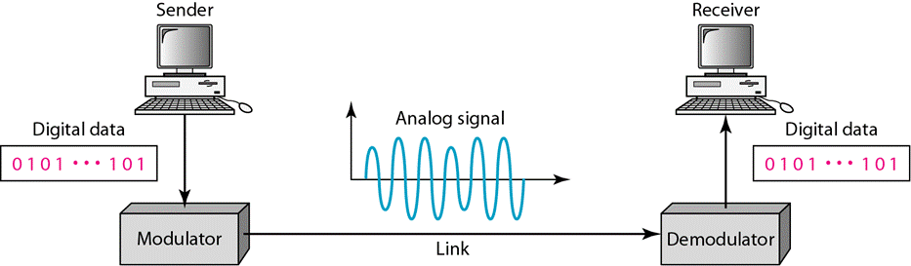
Analog Transmission:
Digital-to-Analog Transmission :
Converting digital data to a band pass analog signal is traditionally called digital-to-analog conversion.
Digital-to-analog conversion is the process of changing one of the characteristics of an analog signal based on the information in digital data.

Slide 5
Analog Transmission:
Digital-to-Analog Transmission :
An analog Signal is defined by three characteristics: amplitude, frequency, and phase.
When we vary anyone of these characteristics, we create a different version of that wave. So, by changing one characteristic of a simple electric signal, we can use it to represent digital data.
So, we have at least three mechanisms for modulating digital data into an analog signal:
Amplitude shift keying (ASK)
Frequency shift keying (FSK)
Phase shift keying (PSK)

Slide 6
Analog Transmission:
Digital-to-Analog Transmission :
Before we discuss specific methods of digital-to-analog modulation, two basic issues must be reviewed: bit and baud rates and the carrier signal.
Bit rate is the number of bits per second. Baud rate is the number of signal elements per second. In the analog transmission of digital data, the baud rate is less than or equal to the bit rate.
The relationship between them is:
S = N /r (baud)
Here N is the data rate (bps) and r is the number of data elements carried in one signal element.

Slide 7
Analog Transmission:
Digital-to-Analog Transmission :
Example:
An analog signal has a bit rate of 8000 bps and a baud rate of 1000 baud. How many data elements are carried by each signal element? How many signal level do we need?
Solution:
In this example, S = 1000, N =8000. Here we have to find r = ? and signal level, L = ?.
S = N /r
r =N/S = 8000/1000 = 8 bits/baud
We know, r = log2 L;
L = 2ˆr = 2ˆ8 = 256

Slide 8
Analog Transmission:
Digital-to-Analog Transmission :
Carrier Signal:
In analog transmission, the sending device produces a high-frequency signal that acts as a base for the information signal. This base signal is called the carrier signal or carrier frequency.
Digital information then changes the carrier signal by modifying one or more of its characteristics (amplitude, frequency, or phase). This kind of modification is called modulation (shift keying).

Slide 9
Analog Transmission:
Digital-to-Analog Transmission :
Amplitude Shift Keying (ASK):
In amplitude shift keying, the amplitude of the carrier signal is varied to create signal elements. Both frequency and phase remain constant while the amplitude changes.
ASK is normally implemented using only two levels. This is referred to as binary amplitude shift keying or on-off keying (OOK). The peak amplitude of one signal level is 0; the other is the same as the amplitude of the carrier frequency.

Slide 10
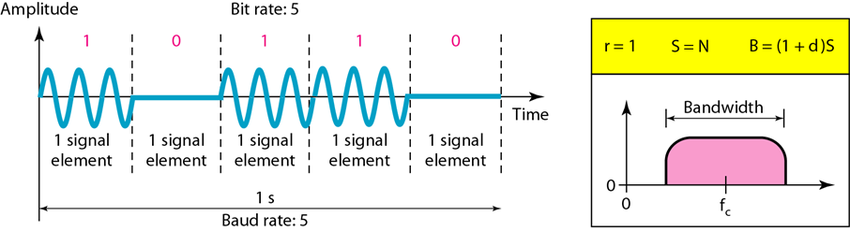
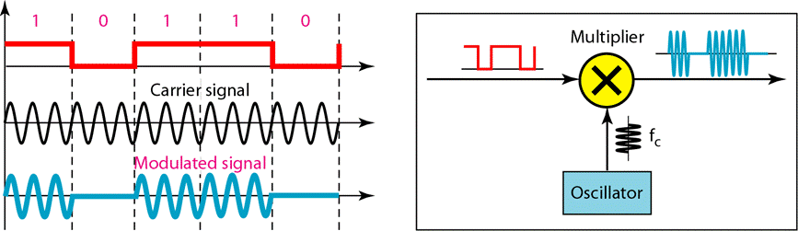
Analog Transmission:
Amplitude Shift Keying (ASK):

Slide 11
Analog Transmission:
Frequency Shift Keying (FSK):
In frequency shift keying, the frequency of the carrier signal is varied to represent data.
The frequency of the modulated signal is constant for the duration of one signal element, but changes for the next signal element if the data element changes.
Both peak amplitude and phase remain constant for all signal elements.
we have selected two carrier frequencies,f1 and f2. We use the first carrier if the data element is 0; we use the second if the data element is 1.

Slide 12
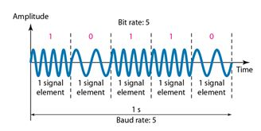
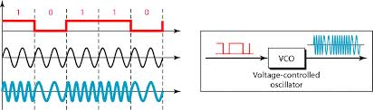
Analog Transmission:

Slide 13
Analog Transmission:
Phase Shift Keying (PSK):
In phase shift keying, the phase of the carrier is varied to represent two or more different signal elements. Both peak amplitude and frequency remain constant as the phase changes. Today, PSK is more common than ASK or FSK.
Noise can change the amplitude easier than it can change the phase. In other words, PSK is less susceptible to noise than ASK. PSK is superior to FSK because we do not need two carrier signals.
The simplest PSK is binary PSK, in which we have only two signal elements, one with a phase of 0°, and the other with a phase of 180°.

Slide 14

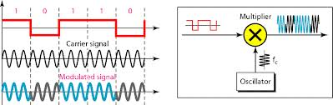
Analog Transmission:
Phase Shift Keying (PSK):

Slide 15
Thanks…
Any Questions ???

